Slide 1
MEASURE OF CENTRAL TENDENCY

Slide 2
MEASURES OF CENTRAL TENDENCY
MEAN
MEDIAN
MODE
SINGLE VALUE THAT REPRESENT THE WHOLE DATA SET

Slide 3
Marks scored by eight students
UNGROUPED DATA
88 | 71 | 60 | 44 | 76 | 82 | 80 | 59
Number of absent days of 66 students
UNGROUPED DATA WITH FREQUENCY
No. of absent days | 0 | 1 | 2 | 3
No. of students | 20 | 21 | 15 | 10
Marks | No. of students (f) | Mid-point (x) | fx
30-39 | 2 | 34.5 | 69
40-49 | 4 | 44.5 | 178
50-59 | 8 | 54.5 | 436
60-69 | 14 | 64.5 | 903
70-79 | 10 | 74.5 | 745
80-89 | 5 | 84.5 | 422.5
90-99 | 1 | 94.5 | 94.5
GROUPED DATA

Slide 4
MEAN
Mean is the average of a set of measurement
UNGROUPED DATA | UNGROUPED DATA WITH FREQUENCY | GROUPED DATA

Slide 5
EXAMPLE: UNGROUPED DATA
Marks scored by eight students
88 | 71 | 60 | 44 | 76 | 82 | 80 | 59
Find the mean of the marks scored by eight students
Solution:
The average mark is 70

Slide 6
Exercise: UNGROUPED DATA
Marks scored by eight students
20 | 40 | 30 | 44 | 76 | 82 | 80 | 59
Find the mean of the marks scored by eight students
Solution:
The average mark is 53.9%

Slide 7
EXAMPLE: UNGROUPED DATA WITH FREQUENCY
Find the mean number absent days of 66 students
No. of absent days | 0 | 1 | 2 | 3
No. of students | 20 | 21 | 15 | 10
Solution:
The average number of absent day is one day

Slide 8
Exercise: UNGROUPED DATA WITH FREQUENCY
Find the mean number of hours a resident switched on the air-cond in a days.
No. of hours | 1 | 2 | 3 | 4
No. of residents | 7 | 20 | 53 | 40
Solution:
The average number of hours a resident switched on the air-cond is 3 hours per day

Slide 9
EXAMPLE: GROUPED DATA
The marks scored by 44 students in Statistics Examination are shown in the table below
Marks | No. of students (f)
30-39 | 2
40-49 | 4
50-59 | 8
60-69 | 14
70-79 | 10
80-89 | 5
90-99 | 1
Find the mean of marks scored by 44 students in Statistics Examination

Slide 10
(30+39)/2=34.5
Solution:
Marks | No. of students (f) | Mid-point (x) | fx
30-39 | 2 | 34.5 | (2x34.5) 69
40-49 | 4 | 44.5 | (4x44.5) 178
50-59 | 8 | 54.5 | (8x54.5) 436
60-69 | 14 | 64.5 | (14x64.5) 903
70-79 | 10 | 74.5 | (10x74.5) 745
80-89 | 5 | 84.5 | (5x84.5) 422.5
90-99 | 1 | 94.5 | (1x94.5) 94.5
Solution:
The average score is 65%

Slide 11
Exercise: GROUPED DATA
The number of individual tax forms prepared by small accounting firms in Perak. The data shown in the table below
Number of tax form | No. of accounting firms(f)
20-30 | 1
30-40 | 15
40-50 | 22
50-60 | 8
60-70 | 4
Find the mean, median and mode of the data above
Mean=44.8, Median=44.1, Mode=43.3

Slide 12
MODE
Mode refers the observation that occurs most often or has the largest frequency in a data set
EXAMPLE: UNGROUPED DATA
3, 5, 2, 0, 1, 4, 3, 3
2, 3, 5, 5, 10, 7, 8, 3
11, 13, 11, 14, 13, 14, 15, 15
Find the mode of the data set above
Solution:
1)
2)
3) There is no modal value

Slide 13
EXAMPLE: UNGROUPED DATA WITH FREQUENCY
Find the modal number of absent days of 66 students
No. of absent days | 0 | 1 | 2 | 3
No. of students | 20 | 21 | 15 | 10
Solution: The modal value is 1 day

Slide 14
EXAMPLE: GROUPED DATA
The marks scored by 44 students in Statistics Examination are shown in the table below
Marks | No. of students (f)
30-39 | 2
40-49 | 4
50-59 | 8
60-69 | 14
70-79 | 10
80-89 | 5
90-99 | 1
Find the mode value and explains its meaning

Slide 15
STEP 2: Find the modal class. (Class with the largest frequency)
STEP 1: Construct class boundary
Marks | No. of students (f) | Class Boundary
30-39 | 2 | 29.5 - 39.5
40-49 | 4 | 39.5 - 49.5
50-59 | 8 | 49.5 - 59.5
60-69 | 14 | 59.5 - 69.5
70-79 | 10 | 69.5 - 79.5
80-89 | 5 | 79.5 - 89.5
90-99 | 1 | 89.5 - 99.5
Marks | No. of students (f) | Class Boundary
30-39 | 2 | 29.5 - 39.5
40-49 | 4 | 39.5 - 49.5
50-59 | 8 | 49.5 - 59.5
60-69 | 14 | 59.5 - 69.5
70-79 | 10 | 69.5 - 79.5
80-89 | 5 | 79.5 - 89.5
90-99 | 1 | 89.5 - 99.5

Slide 16
STEP 3: Mode,
Where = lower class boundary of the modal class
= difference between the frequency of the modal class and frequency before it
= difference between the frequency of the modal class and frequency after it
C = class size of the modal class
Marks | No. of students (f) | Class Boundary
30-39 | 2 | 29.5 - 39.5
40-49 | 4 | 39.5 - 49.5
50-59 | 8 | 49.5 - 59.5
60-69 | 14 | 59.5 - 69.5
70-79 | 10 | 69.5 - 79.5
80-89 | 5 | 79.5 - 89.5
90-99 | 1 | 89.5 - 99.5
= 14 – 8 = 6
= 14 – 10 = 4
Most of the students scored 65.5%

Slide 17
MEDIAN
Median is a value that is exactly in the middle position of the list when the data values are ranked ( according to ascending order )
Meaning: 50% of all the observation is less than the median value and another 50% is more than the median value
EXAMPLE: UNGROUPED DATA
STEP 3: Median =
Calculate the median
88 71 60 44 76 82 59
50% of 8 students scored less than 73.5 and another 50% scored more than 73.5
STEP 1: Arrange the data according to ascending order
44 59 60 71 76 80 82 88
STEP 2: Position of the median =
44 59 60 71 76 80 82 88
4.5

Slide 18
EXAMPLE: UNGROUPED DATA WITH FREQUENCY
Find the median number of absent days of 66 students
No. of absent days | 0 | 1 | 2 | 3
No. of students | 20 | 21 | 15 | 10
Solution:
STEP 1: Construct cumulative frequency
No. of absent days | 0 | 1 | 2 | 3
No. of students | 20 | 21 | 15 | 10
Cumulative freq | 20 | 41 | 56 | 66
STEP 2: Position of the median =
Median = 1

Slide 19
EXAMPLE: GROUPED DATA
The marks scored by 44 students in Statistics Examination are shown in the table below
Marks | No. of students (f)
30-39 | 2
40-49 | 4
50-59 | 8
60-69 | 14
70-79 | 10
80-89 | 5
90-99 | 1
Find the median value and explains its meaning

Slide 20
STEP 1: Construct class boundary and cumulative frequency
Marks | No. of students (f) | Class Boundary | Cumulative Frequency
30-39 | 2 | 29.5 - 39.5 | 2
40-49 | 4 | 39.5 - 49.5 | 6
50-59 | 8 | 49.5 - 59.5 | 14
60-69 | 14 | 59.5 - 69.5 | 28
70-79 | 10 | 69.5 - 79.5 | 38
80-89 | 5 | 79.5 - 89.5 | 43
90-99 | 1 | 89.5 - 99.5 | 44
STEP 2: Position of the median =

Slide 21
STEP 3: Median,
Where = total frequency = n
= lower class boundary of a median class
= frequency of a median class
= cumulative frequency before the median class
C = class size of the median class
50% of students scored less than 65.2 and another 50% of students scored more than 65.2

Slide 22
Median from ogive?
Number of cars
Ogive that shows the distribution of parking charges collected (RM)
100
90
x
x
80
x
70
Position of Median = 45
60
x
50
x
40
30
20
x
Median = RM12
10
0
x
x
0.5
4.5
8.5
12.5
16.5
20.5
24.5
28.5
Parking charges per car (RM)
PAGE 37

Slide 23
MEASURES OF POSITION
FIRST QUARTILE,
Q1
THIRD QUARTILE,
Q3
SECOND QUARTILE/MEDIAN,
Q2
Q1: 25% of all observations < Q1 and another 75% > Q1
Q2: Median
Q3: 75% of all observations < Q3 and another 25% > Q3

Slide 24
UNGROUPED DATA
EXAMPLE : CALCULATE LOWER ,MEDIAN AND UPPER QUARTILE
88 71 60 44 76 82 80 59
STEP 1: Arrange the data according to ascending order
44 59 60 71 76 80 82 88
1
2
3
4
5
6
7
8
POSITION
STEP 2: Find Q1
Position Q1 :
Q1 : 59 + 0.25 ( 60- 59) = 59.25
COMMENT:
25 % of 8 students scored less than 59.25 and another 75% scored more than 59.25

Slide 25
UNGROUPED DATA
EXAMPLE : CALCULATE LOWER ,MEDIAN AND UPPER QUARTILE
STEP 1: Arrange the data according to ascending order
44 59 60 71 76 80 82 88
1
2
3
4
5
6
7
8
POSITION
STEP 3: Find Q2
Position Q2 :
Q2 : 71 + 0.5 ( 76- 71) = 73.5
COMMENT:
50% of 8 students scored less than 73.5 and another 50% scored more than 73.5

Slide 26
UNGROUPED DATA
EXAMPLE : CALCULATE LOWER ,MEDIAN AND UPPER QUARTILE
STEP 1: Arrange the data according to ascending order
44 59 60 71 76 80 82 88
1
2
3
4
5
6
7
8
POSITION
STEP 3: Find Q3
Position Q3 :
Q3 : 80 + 0.75 ( 82- 80) = 81.5
COMMENT:
75% of 8 students scored less than 81.5 and another 25% scored more than 81.5

Slide 27
EXAMPLE: GROUPED DATA
The marks scored by 44 students in Statistics Examination are shown in the table below
Marks | No. of students (f)
30-39 | 2
40-49 | 4
50-59 | 8
60-69 | 14
70-79 | 10
80-89 | 5
90-99 | 1
Find Q1 and Q3

Slide 28
STEP 1: Construct class boundary and cumulative frequency
Marks | No. of students (f) | Class Boundary | Cumulative Frequency
30-39 | 2 | 29.5 - 39.5 | 2
40-49 | 4 | 39.5 - 49.5 | 6
50-59 | 8 | 49.5 - 59.5 | 14
60-69 | 14 | 59.5 - 69.5 | 28
70-79 | 10 | 69.5 - 79.5 | 38
80-89 | 5 | 79.5 - 89.5 | 43
90-99 | 1 | 89.5 - 99.5 | 44
STEP 2: Position of the Q1 =

Slide 29
STEP 3:
Where = total frequency = n
= lower class boundary of a Q1 class
= frequency of a Q1 class
= cumulative frequency before the Q1 class
C = class size of the Q1 class
25 % of students scored less than 55.75 and another 75% scored more than 55.75

Slide 30
STEP 1: Construct class boundary and cumulative frequency
Marks | No. of students (f) | Class Boundary | Cumulative Frequency
30-39 | 2 | 29.5 - 39.5 | 2
40-49 | 4 | 39.5 - 49.5 | 6
50-59 | 8 | 49.5 - 59.5 | 14
60-69 | 14 | 59.5 - 69.5 | 28
70-79 | 10 | 69.5 - 79.5 | 38
80-89 | 5 | 79.5 - 89.5 | 43
90-99 | 1 | 89.5 - 99.5 | 44
STEP 4: Position of the Q3 =

Slide 31
STEP 5:
Where = total frequency = n
= lower class boundary of a Q3 class
= frequency of a Q3 class
= cumulative frequency before the Q3 class
C = class size of the Q3 class
75 % of students scored less than 74.5 and another 25% scored more than 74.5

Slide 32
INTERQUARTILE RANGE
Range of the middle 50% of the data
Q1 : 55. 75 and Q3 : 74.5

Slide 33
QUARTILE DEVIATION
Semi-inter quartile range
Q1 : 55. 75 and Q3 : 74.5

Slide 34
RANGE
The difference between the largest and smallest value in the data sets
UNGROUPED DATA
Range = Max value – Min value
EXAMPLE 37:
GROUP A : 20 30 40 50 60 70
GROUP B : 40 42 43 45 45 55
GROUP A : 70-20 = 50
GROUP B : 55-40= 15
Group A has greater dispersion.

Slide 35
RANGE
GROUPED DATA
Range = UCB of last class – LCB of the first class
Marks | Class Boundary | No. of students (f)
25-29 | 24.5- 29.5 | 2
30-34 | 29.5- 34.5 | 3
35-39 | 34.5- 39.5 | 5
40-44 | 39.5- 44.5 | 7
45-49 | 44.5- 49.5 | 9
50-54 | 49.5- 54.5 | 2
Range = 54.5- 24.5 = 30

Slide 36
MEASURES OF DISPERSION
COEFFICENT OF VARIATION
MEAN DEVIATION
STANDARD DEVIATION

Slide 37
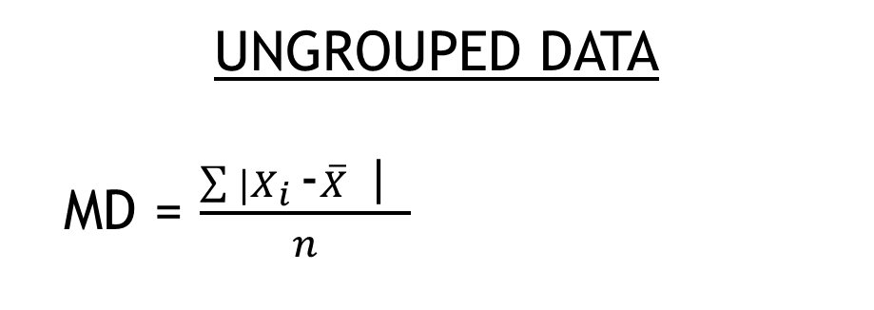
MEAN DEVIATION
An absolute measure of the dispersion of a set of data.
Measures the average differences between the actual values and the mean of the dataset.
UNGROUPED DATA
MD = $\frac{\sum{|X_{i }}\text{−}\overline{X}\text{ | }}{n}$
EXAMPLE 39:
20 30 40 10 50
STEP 1: Calculate mean

Slide 38
STEP 2: Calculate MD

Slide 39
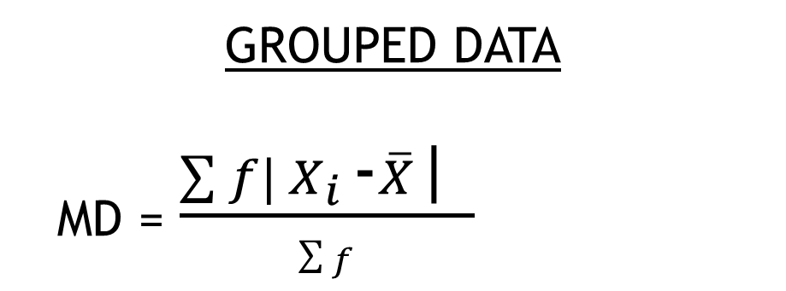
GROUPED DATA
MD = $\frac{\sum{f|{ X}_{i }}\text{−}\overline{X}\text{| }}{\sum{f}}$
EXAMPLE 40:Determine the mean deviation of the following data
Class | x | f
0-5 | 2.5 | 4
5-10 | 7.5 | 4
10-15 | 12.5 | 20
15-20 | 17.5 | 10
20-25 | 22.5 | 2

Slide 40
STEP 1: Calculate mean

Slide 41

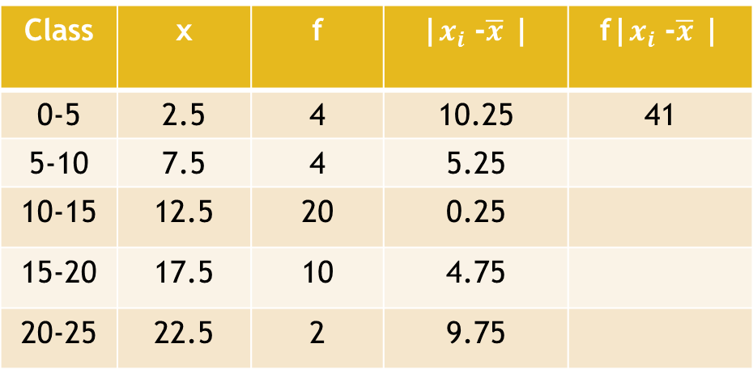

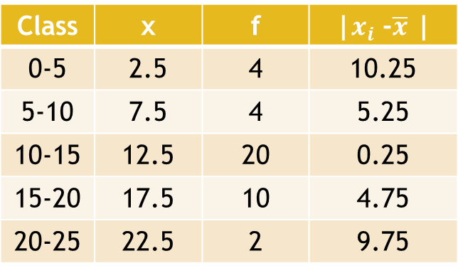
STEP 4: Calculate MD
STEP 2: Calculate |$x_{i}$ -$\overline{x}$ |
Class | x | f | |$x_{i}$ -$\overline{x}$ |
0-5 | 2.5 | 4 | 10.25
5-10 | 7.5 | 4 | 5.25
10-15 | 12.5 | 20 | 0.25
15-20 | 17.5 | 10 | 4.75
20-25 | 22.5 | 2 | 9.75
STEP 3: Calculate f.|$x_{i}$ -$\overline{x}$ |
Class | x | f | |$x_{i}$ -$\overline{x}$ | | f|$x_{i}$ -$\overline{x}$ |
0-5 | 2.5 | 4 | 10.25 | 41
5-10 | 7.5 | 4 | 5.25
10-15 | 12.5 | 20 | 0.25
15-20 | 17.5 | 10 | 4.75
20-25 | 22.5 | 2 | 9.75
Sum/total =134

Slide 42
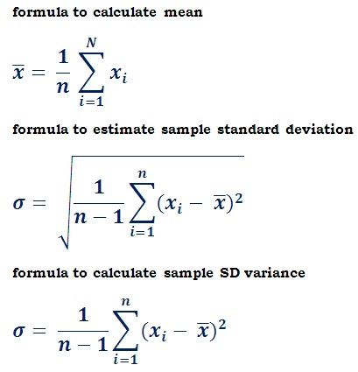
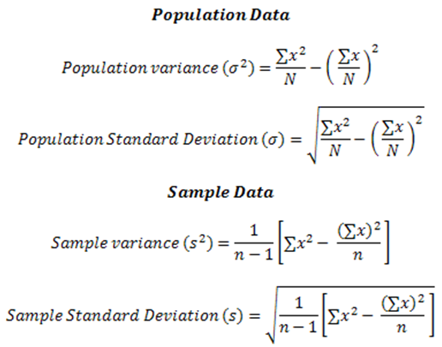
STANDARD DEVIATION
The squared root of the average of the squared distances of the observations from the mean.
UNGROUPED DATA
Formula 1 : s =
Formula 2 : s =

Slide 43
EXAMPLE 41: Which data set has less dispersion ?
Group A : 20 30 40 50 60 70
Group B : 40 42 43 45 45 55
Solution by using Formula 1:
STEP 1: Calculate mean

Slide 44

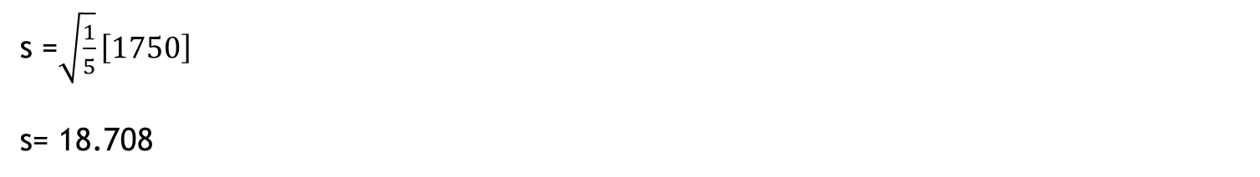
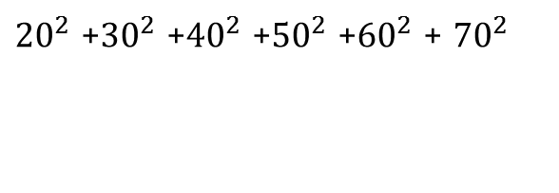
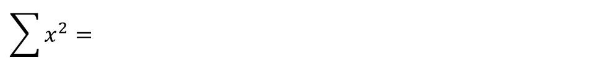
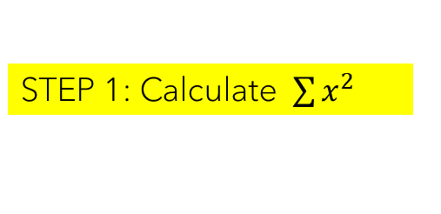
STEP 2: Calculate $s$
s = $\sqrt{\frac{1}{6−1}{[20−45]}^{2}+{[30−45]}^{2}+{[40−45]}^{2}+{[50−45]}^{2}+{[60−45]}^{2}+{[70−45]}^{2}}$
s =$\sqrt{\frac{1}{5}}\left[1750\right]$
s= 18.708
Solution by using Formula 2:
STEP 1: Calculate $\sum{x^{2}}$
$$\sum{x^{2}= }$$
${20}^{2}$ +${30}^{2}$ +${40}^{2}$ +${50}^{2}$ +${60}^{2}$ + ${70}^{2}$
= 13900

Slide 45
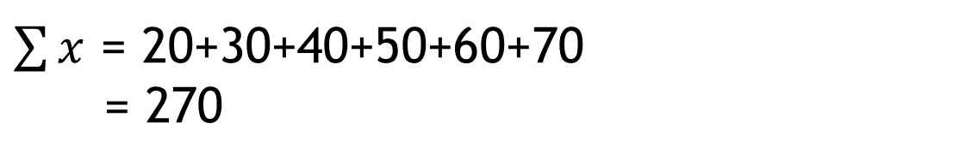
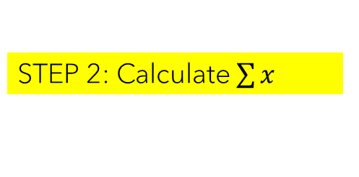
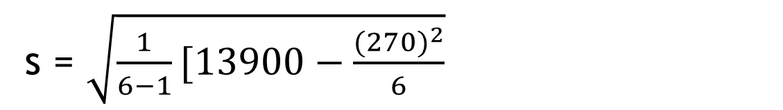

STEP 2: Calculate $\sum{x}$
$\sum{x}$ = 20+30+40+50+60+70
= 270
STEP 3: Calculate $s$
s = $\sqrt{\frac{1}{6−1}[13900−\frac{{(270)}^{2}}{6}}$
s =18.708

Slide 46
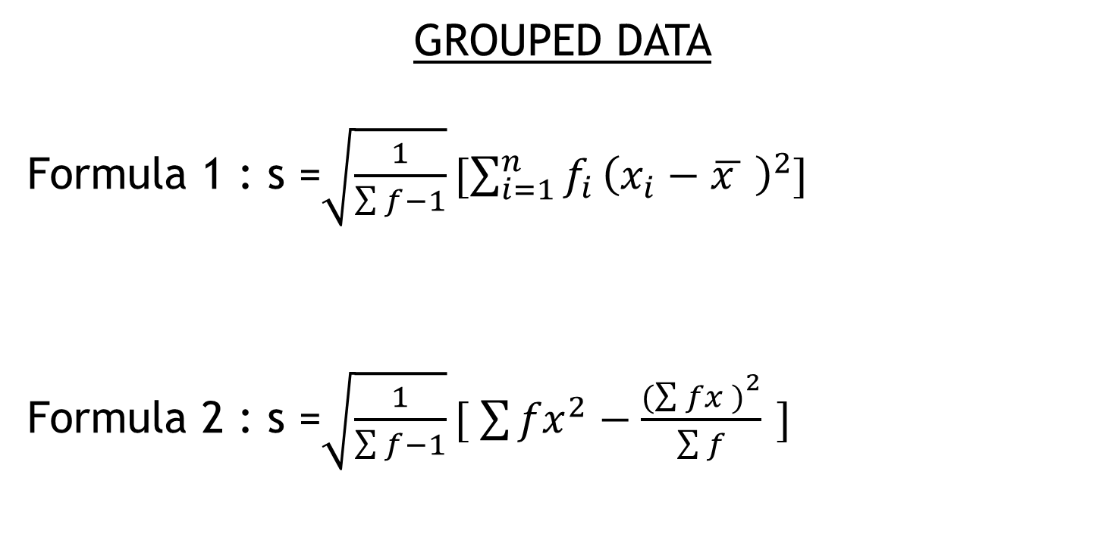
GROUPED DATA
Formula 1 : s =$\sqrt{\frac{1}{\sum{f−1}}}[\sum_{i=1}^{n}{f_{i}}{\left(x_{i}−\overline{x } \right)}^{2}]$
Formula 2 : s =$\sqrt{\frac{1}{\sum{f−1}}}[ \sum{{fx}^{2}}−\frac{{(\sum{fx )}}^{2}}{\sum{f}}$ $]$

Slide 47
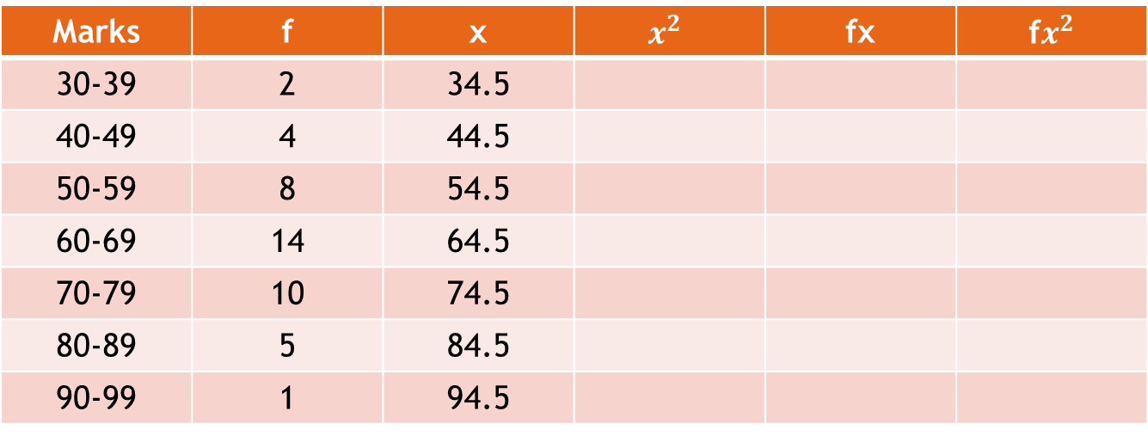
EXAMPLE 42:Calculate the standard deviation for the data below.
Marks | f | x | $$x^{2}$$ | fx | f$x^{2}$
30-39 | 2 | 34.5
40-49 | 4 | 44.5
50-59 | 8 | 54.5
60-69 | 14 | 64.5
70-79 | 10 | 74.5
80-89 | 5 | 84.5
90-99 | 1 | 94.5

Slide 48
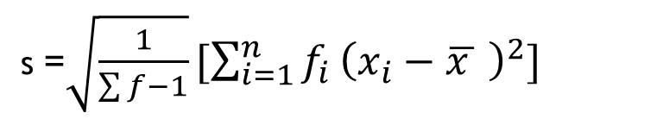
Solution by using Formula 1:
s =$\sqrt{\frac{1}{\sum{f−1}}}[\sum_{i=1}^{n}{f_{i}}{\left(x_{i}−\overline{x } \right)}^{2}]$

Slide 49
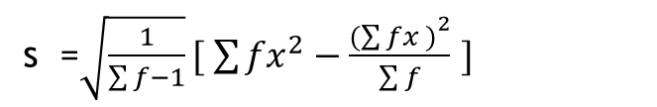
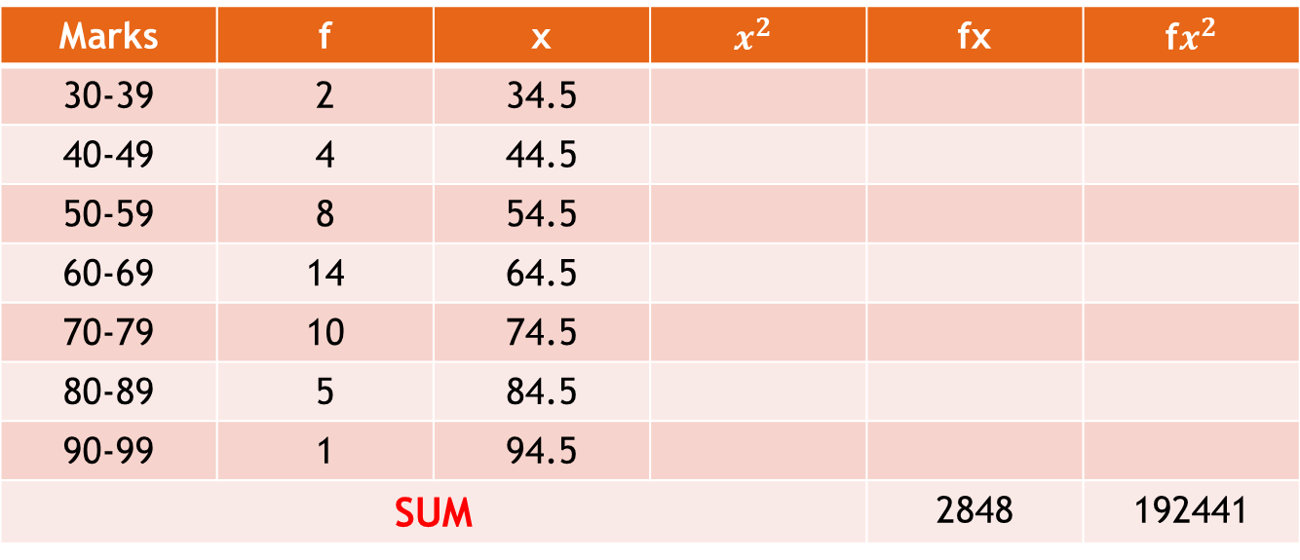
Solution by using Formula 2:
s =$\sqrt{\frac{1}{\sum{f−1}}}[ \sum{{fx}^{2}}−\frac{{(\sum{fx )}}^{2}}{\sum{f}}$ $]$
Marks | f | x | $$x^{2}$$ | fx | f$x^{2}$
30-39 | 2 | 34.5
40-49 | 4 | 44.5
50-59 | 8 | 54.5
60-69 | 14 | 64.5
70-79 | 10 | 74.5
80-89 | 5 | 84.5
90-99 | 1 | 94.5
SUM |  |  |  | 2848 | 192441

Slide 50
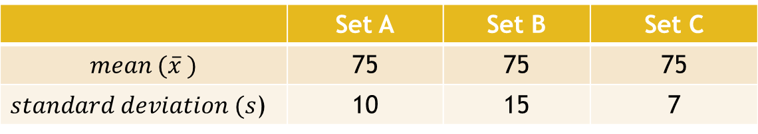
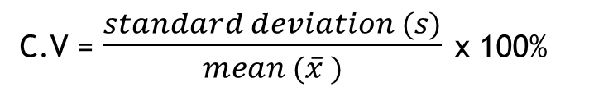
COEFFICENT OF VARIATION
C.V = $\frac{standard deviation (s)}{mean (\overline{x} )}$ x 100%
NOTE : The smaller value of CV shows the dispersion is more consistent.
Example : Calculate the coefficient of variation for each set below.
 | Set A | Set B | Set C
$$mean (\overline{x} )$$ | 75 | 75 | 75
$standard deviation (s$) | 10 | 15 | 7

Slide 51
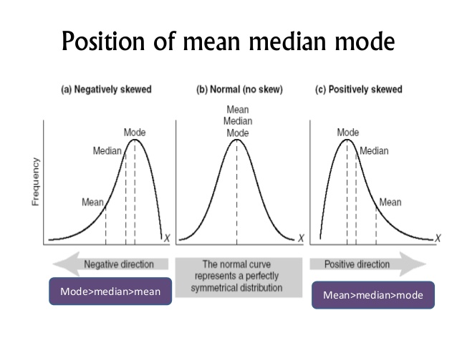
MEASURES OF SKEWNESS
Histogram and Frequency Polygon and (b) Relationship among mean, median and mode.
This can be use to determine the shape of distribution.

Slide 52
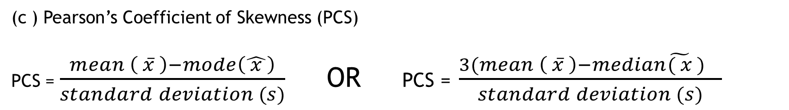
MEASURES OF SKEWNESS
(c ) Pearson’s Coefficient of Skewness (PCS)
PCS = $\frac{mean \left( \overline{x} \right)−mode\left(\hat{ x }\right)}{standard deviation (s)}$ OR PCS = $\frac{3(mean \left( \overline{x} \right)−median\tilde{( x} ) }{standard deviation (s)}$
If PCS = 0 , the distribution is symmetry
If PCS < 0 , the distribution is skewed to the left/negative skew
If PCS > 0 , the distribution is skewed to the right/positive skew

Slide 53
MEASURES OF SKEWNESS
(d ) Box and Whiskers Plot
Example : Construct a box and whiskers plot .
23,15,18,20,17,8,13,10,18,15,20,15,14,14,19,29,5,17,20,12,11,9,12
Solution :
5,8,9,10,11,12,12,13,14,14,15,15,15,17,17,18,18,19,20,20,20,23,29
STEP 1: Arrange in ascending order
6
Position of Q1=
Q1= 12
STEP 2: Find Q1,Q2 and Q3

Slide 54
MEASURES OF SKEWNESS
12
5,8,9,10,11,12,12,13,14,14,15,15,15,17,17,18,18,19,20,20,20,23,29
Position of Q2=
Q2= 15
18
5,8,9,10,11,12,12,13,14,14,15,15,15,17,17,18,18,19,20,20,20,23,29
Position of Q3=
Q3= 19

Slide 55
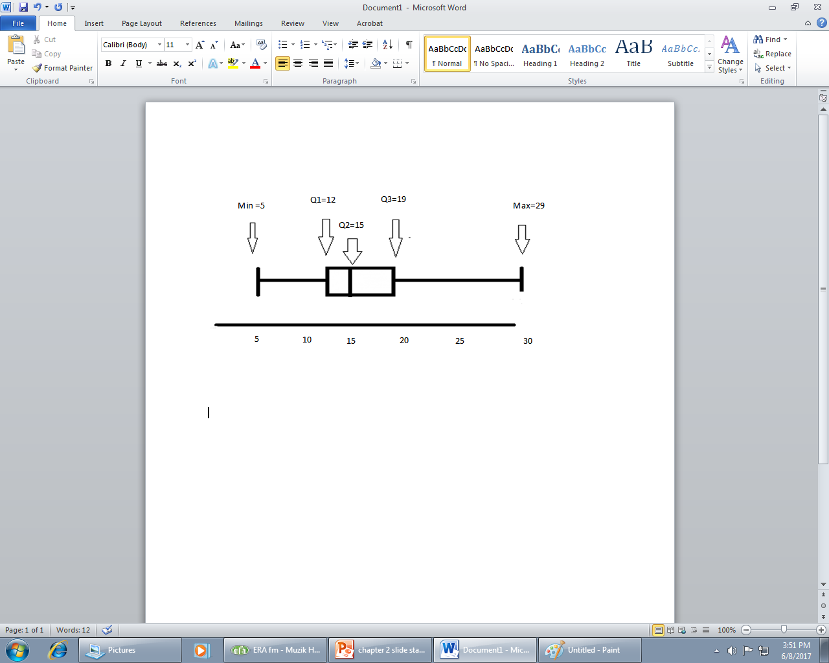
MEASURES OF SKEWNESS
STEP 3: Draw box and plot
COMMENT : SKEW TO THE RIGHT/POSITIVELY SKEWED

Slide 56
End of chapter

